Slide 1

PES’s Modern College of Engineering, Department of Information Technology
Stock Candle
Project Group ID : 06
Guide : Prof. Yogita Fatangare
Group Members
1. Utkarsha M Abhang (45001)
2. Piyush S Adhalikar (45002)
3. Atharva M Mulay (45051)
4. Anushka M Mulay (45050)

Slide 2
Introduction
It represents the residual assets of the company.
Stock market prediction is the act of trying to determine the future value of a company stock or other financial instrument traded on an exchange.
The successful prediction of a stock's future price could yield significant profit.
The result of the analysis are fed to ARIMA model, which then predicts the percentage change in stock price.
Complex machine learning algorithms such as deep learning methods can analyze and detect complex data patterns.

Slide 3
Problem Statement
To predict and analyze the stock price of the company with the help of historical data and present data using
ARIMA.

Slide 4
Objective
To analyze the stock market.
To predict the price of the specific company
To predict stocks pattern and prepare pattern chart using ARIMA model.
To statistically analyze extracted features from pre-processed pattern of stock.

Slide 5
Scope
User can see predictions about bank nifty.
Latest news about IPOs and FPOs.
Daily news about stocks.
We are using LSTM , ARIMA algorithm for stock pattern and prediction.

Slide 6
Abstract
In the era of big data, deep learning for predicting stock market prices and trends has become even more popular than before.
We will be collecting 6 months of data from API and will propose a comprehensive customization of feature engineering and deep learning-based model for predicting price trend of stock markets.
The proposed solution will include pre-processing of the stock market dataset, utilization of multiple feature engineering techniques, combined with a customized deep learning based system for stock market price trend prediction.

Slide 7
Modules
User
Admin
Prediction

Slide 8
1) User
When user will enter the web application, he/she will see the stock related news on the home page.
Everyday top stocks will appear on the home page. Also there will be a search bar, if a user searches for the stock, he/she will see the stock information of the company.
User can also see the predictions of that stock.

Slide 9
2) Admin
Admin takes the stock data from Yahoo finance API.
Admin will train the data using ARIMA model.
The data set from Yahoo finance API contains information like previous closing, opening, high, low, volume of the stock of that company.

Slide 10
3) Prediction
Using various best algorithms to improve the accuracy of stock prediction we proposes a stock price method based on ARIMA for the stock closing price of the next days.
We can adopt LSTM to efficiently extract features from the data which are the items of the previous 6 months.
And then, we will adopt ARIMA to predict the stock price with the extracted feature data.

Slide 11
Literature Review
The data set from website [1,2], we will extract past 1 year of data; For data acquisition, firstly, we will perform web-scraping on NIFTY 50 wiki page for data collection. Then we will use API to fetch stock data for past 1 year.
Use of machine learning and/or deep learning models[3] to accumulate the price data. The data needs to be analyzed and then fitted to match the model. This is what makes it possible to predict future stock prices over a set timetable.
TensorFlow will be used as a backend for ARIMA model will be used to fetch the historical stock data.

Slide 12
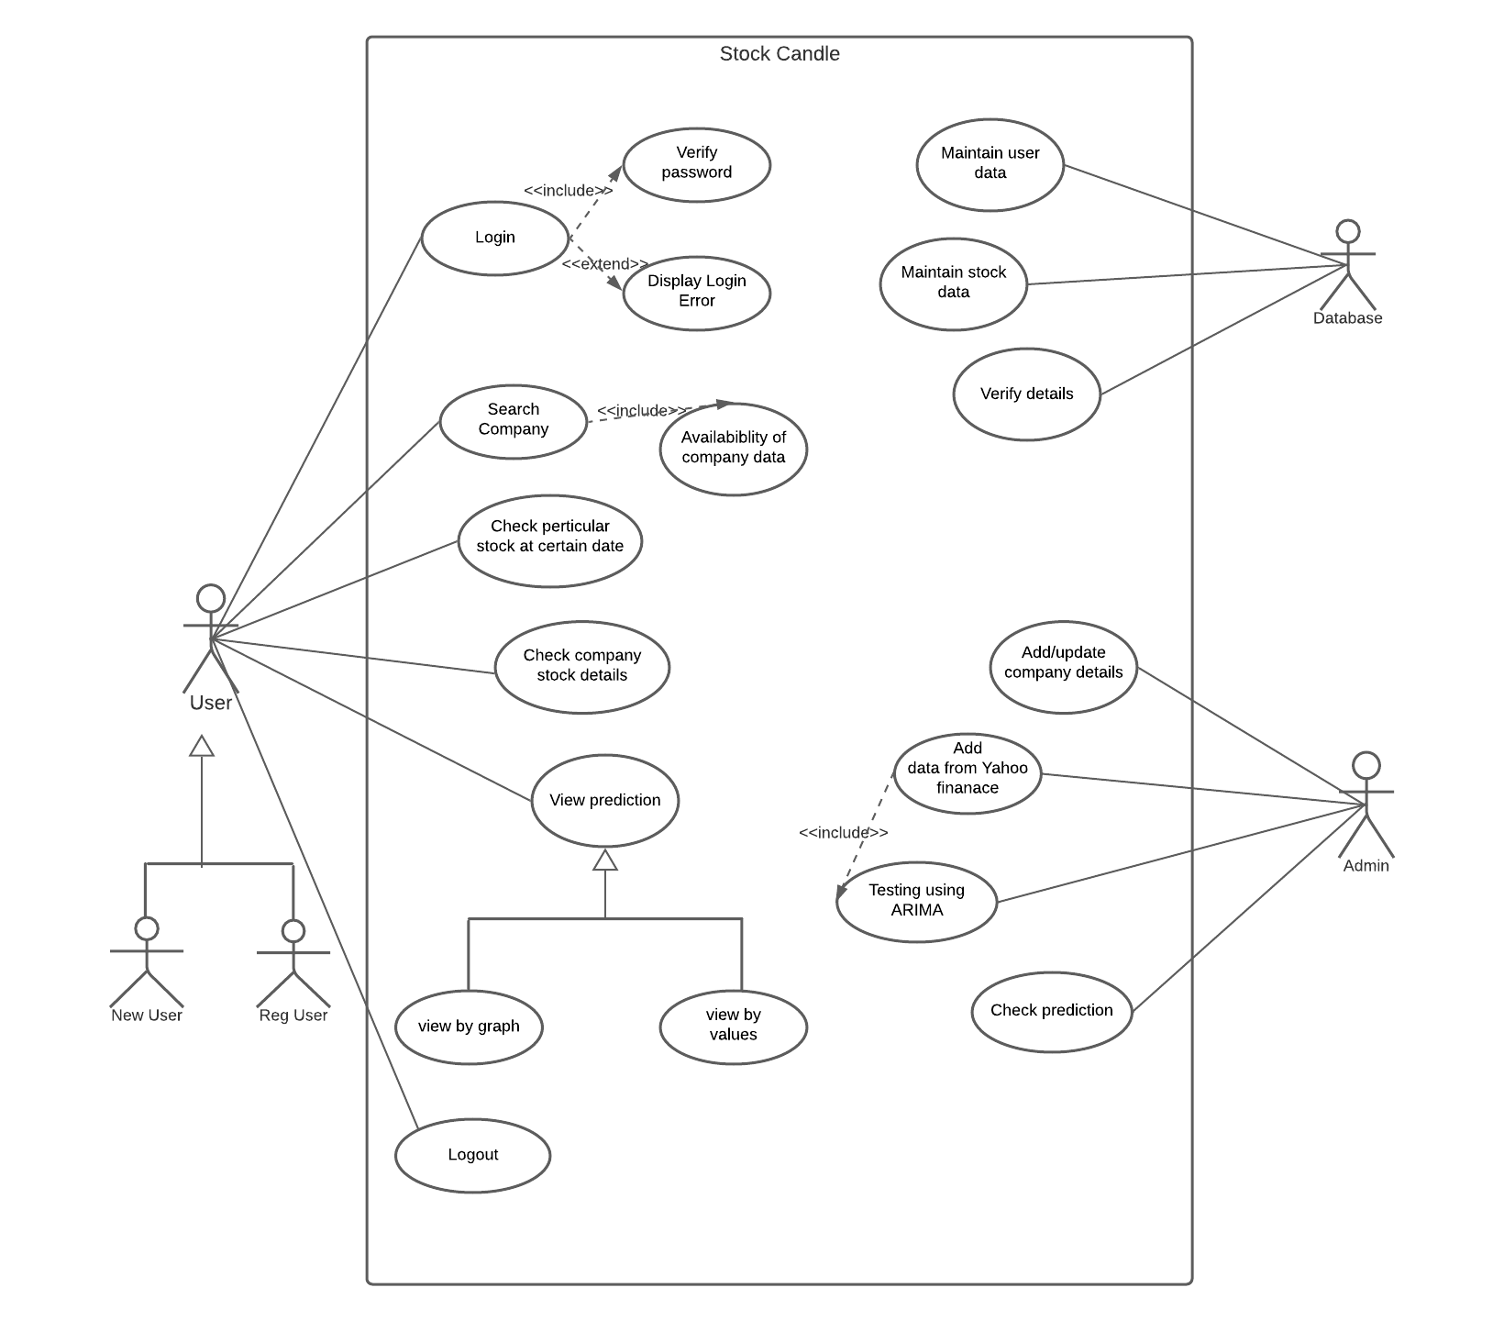
Use Case Diagram

Slide 13
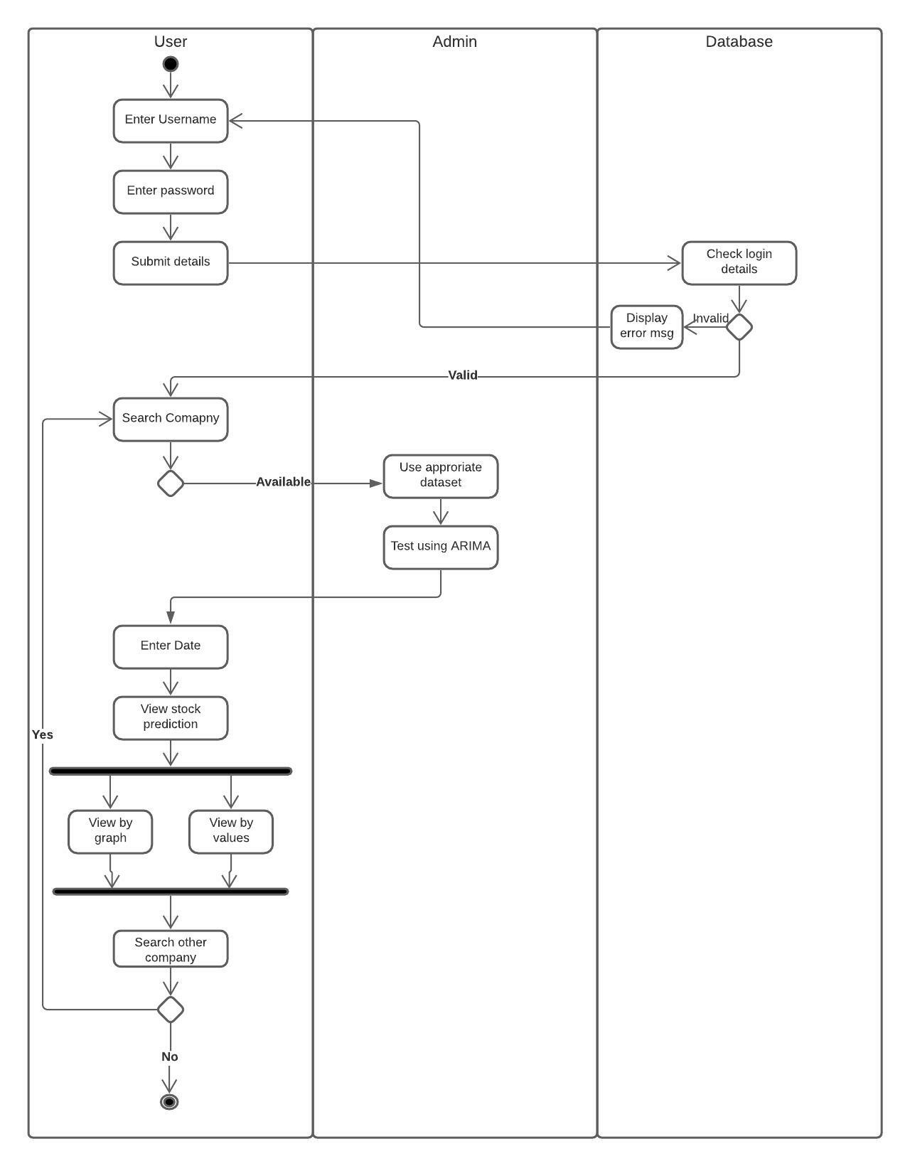
Activity Diagram

Slide 14
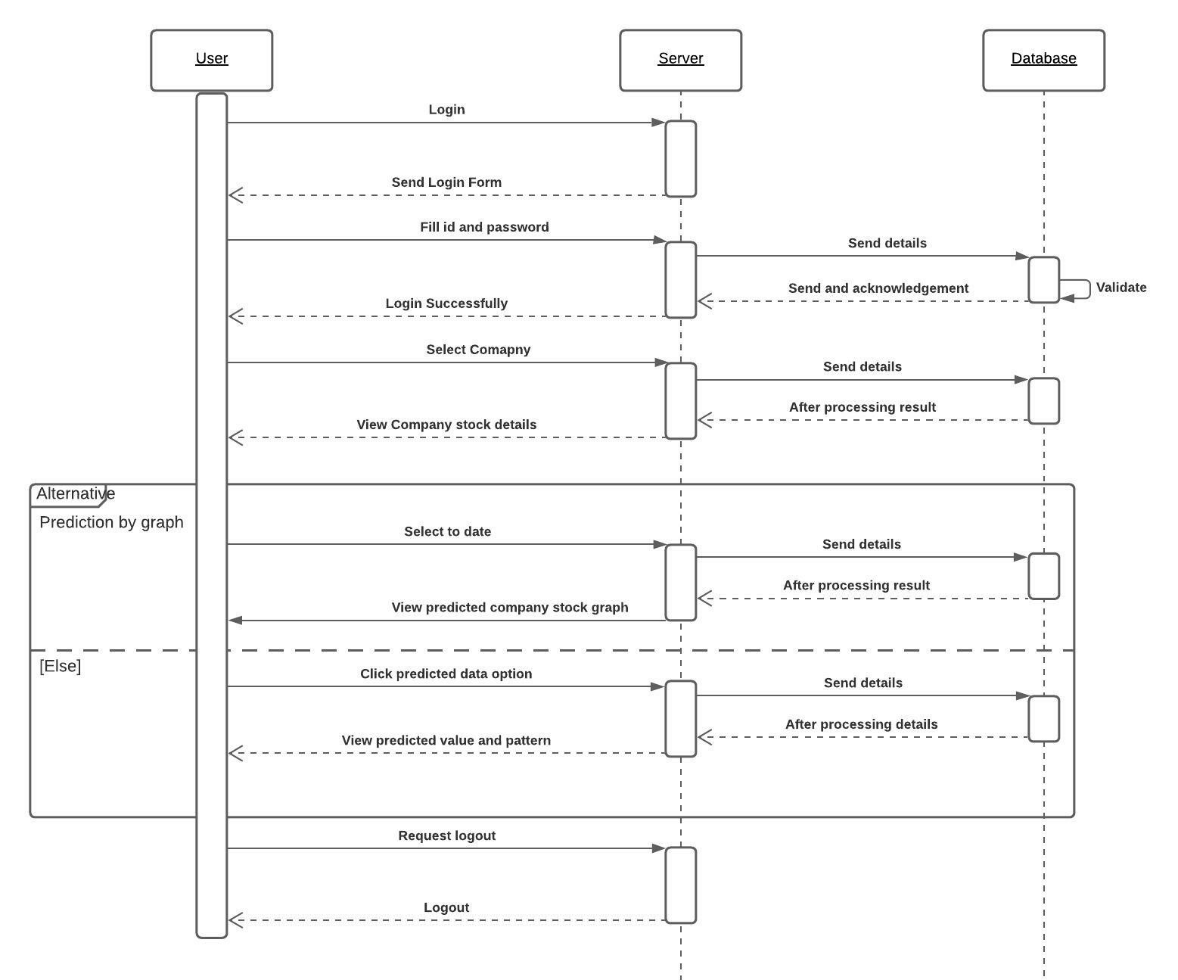
Sequence Diagram

Slide 15
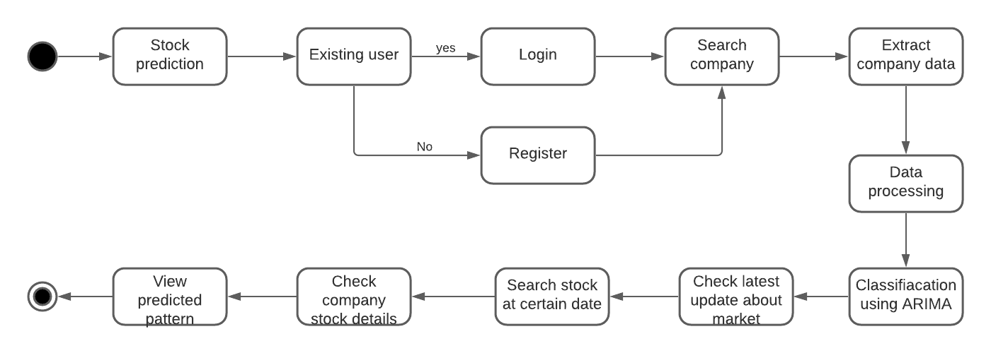
State Chart Diagram

Slide 16
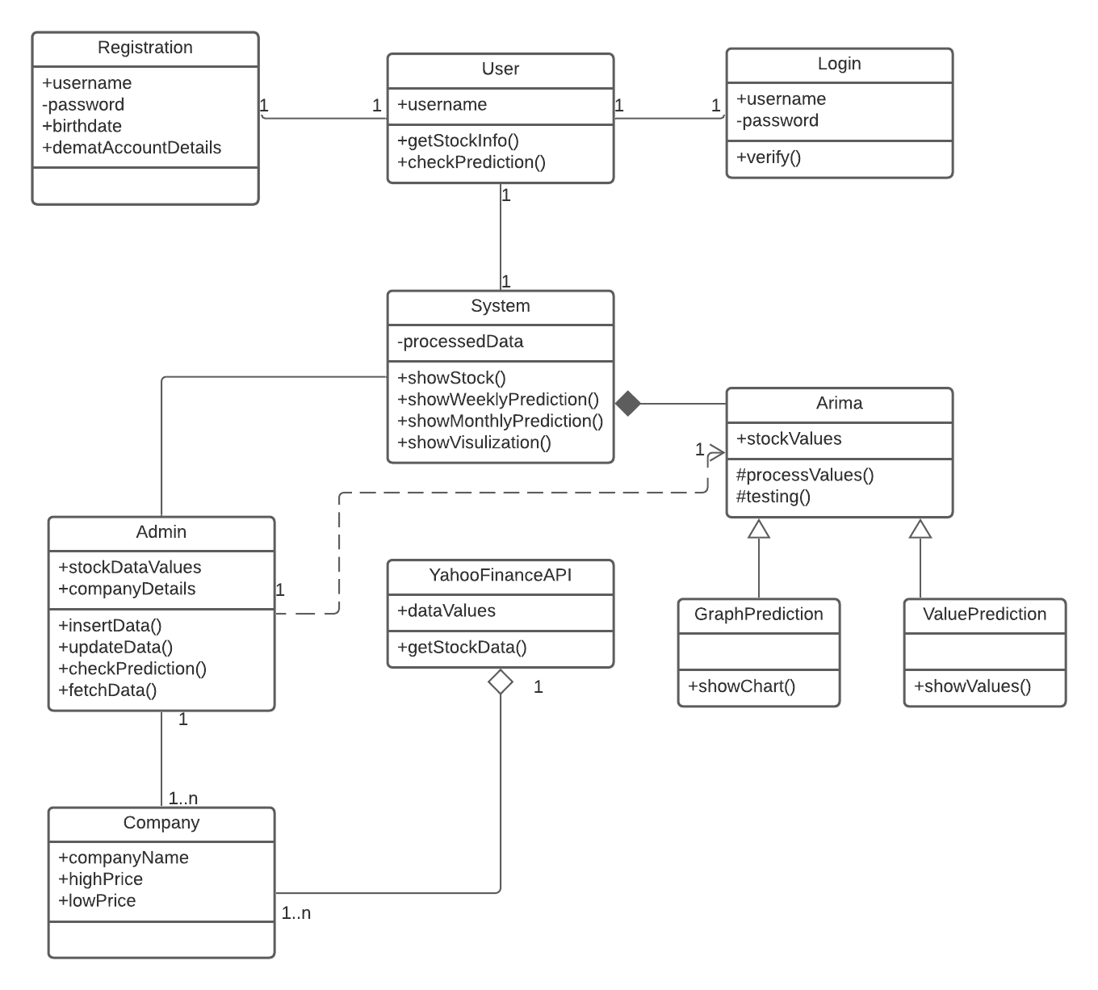
Class Diagram

Slide 17
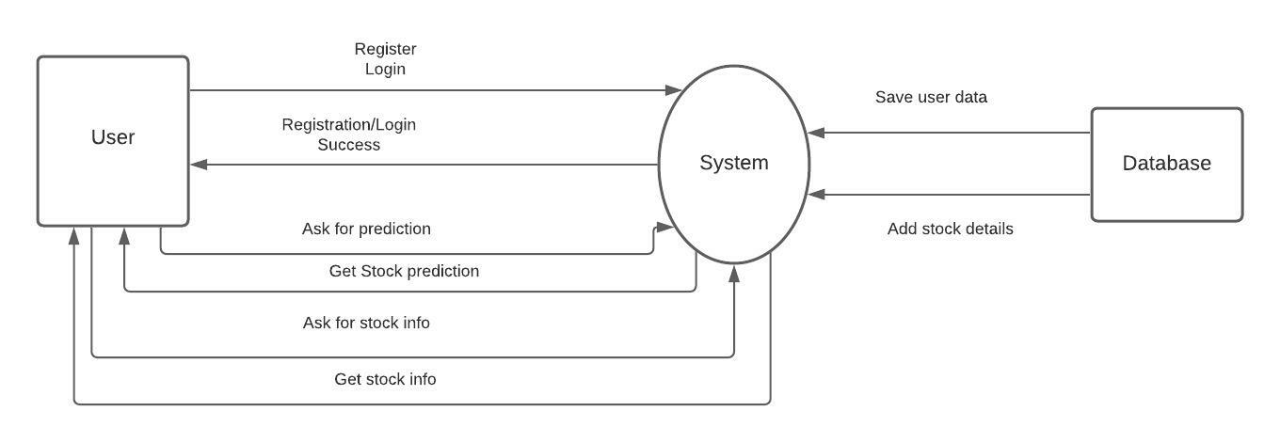
Data Flow Diagram

Slide 18
References
Nifty 50 Yahoo Finance (https://in.finance.yahoo.com/quote/^NSEI/history/ )
(https://www.kaggle.com/rohanrao/nifty50-stock-market-data )
Indian stock market prediction using artificial neural networks on tick data (https://jfin-swufe.springeropen.com/articles/10.1186/s40854-019-0131-7 )

Slide 19
4. Marc Velay and Fabrice Daniel, “Stock Chart Pattern recognition with Deep Learning”, Researchgate, June 2018
5. Victor Skuratov, Konstantin Kuzmin, Igor Nelin, Mikhail Sedankin, “Application of a convolutional neural network to create a detector of technical analysis figures on exchange quotes charts”, (2019), «EUREKA: Physics and Engineering» Number 6 DOI: 10.21303/2461-4262.2019.001055
6. International Journal of Current Trends in Engineering & Technology Volume: 02, Issue: 01 (JAN-FAB, 2016) 18 Stock Market Prediction Using Support Vector Machine Mr. Sachin Sampat Patil, Prof. Kailash Patidar, Assistant Prof. Megha Jain
7. Genetic Algorithm-Optimized Long Short-Term Memory Network for Stock Market Prediction Hyejung Chung and Kyung-shik Shin Sustainability 2018, 10, 3765; doi:10.3390/su10103765

Slide 20


